Slide 1
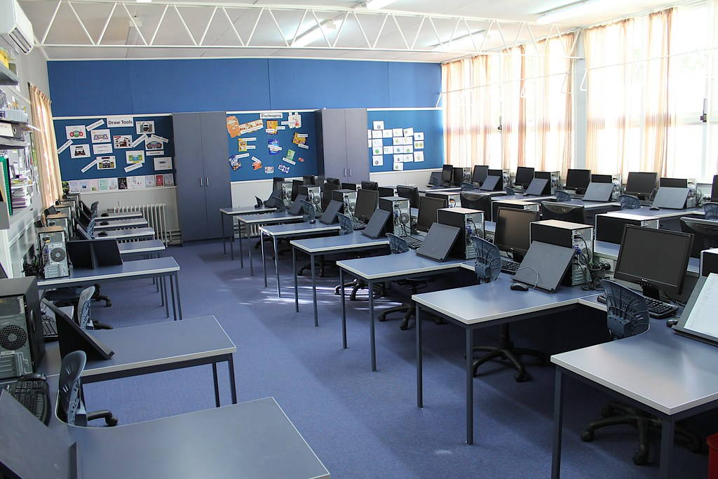

IT Fest
At AMU
_____________________________
26 Aug
4:15 pm
All Computer Science
student are invited
to join the event.

